Slide 1

Economic Crossroads:
From Recovery to Sustainable Growth
Riga - November 24, 2011
EU development strategy
and
implications for the Baltic region
Andres Arrak
Estonia
andres.arrak@gmail.com

Slide 2

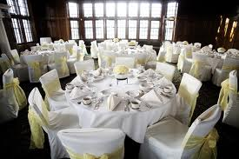
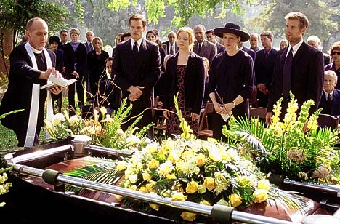
Is it a wedding party or a funeral?

Slide 3
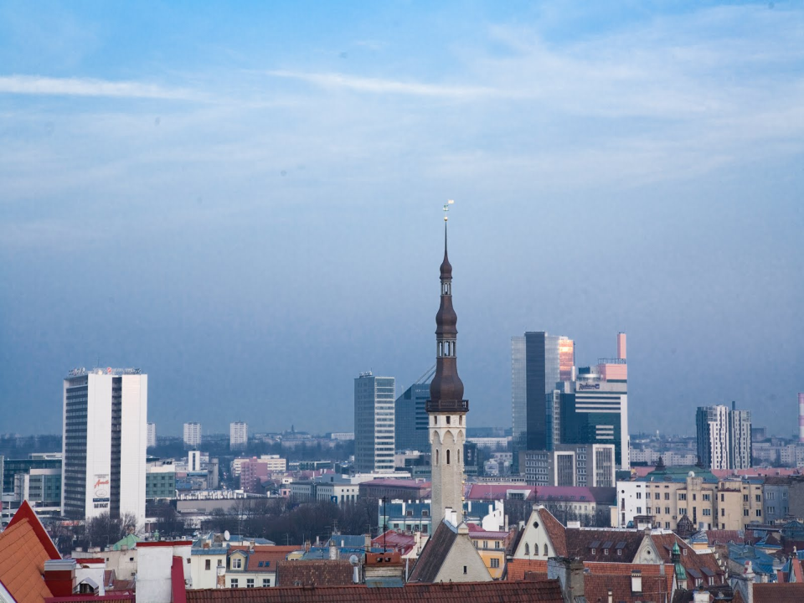
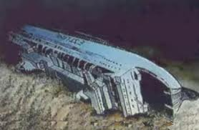
How Estonia has done?
… depend’s how the others have

Slide 4

15,0
10,0
5,0
0,0
GREAT
ERROR
-
5,0
-
10,0
Estonian real GDP growth
fastest growing European economy
-
15,0
-
20,0
III
94'I
III
95'I
III
96'I
III
97'I
III
98'I
III
99'I
III
00'I
III
01'I
III
02'I
III
03'I
III
04'I
III
05'I
III
06'I
III
07'I
III
08'I
III
09'I
III
10'I
III
11'I
III

Slide 5

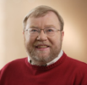
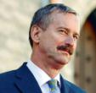
12,0
GLOBAL
ECONOMIC
SLOWDOWN
11,4
10,5
10,5
10,0
7,9
8,0
8,1
8,0
7,1
7,3
6,5
6,0
5,5
Why do economic
crisis occur?
4,3
4,3
4,0
ESTONIAN
ECONOMIC
MODEL
2,0
0,0
0,0
-2,0
-1,6
-1,5
JOINING EU:
1. NEW MARKETS,
2. LOW %,
3. LOAN AND REAL
ESTATE BOOM,
4. SHORTAGE OF
LABOR.
-4,0
Russian crisis
-6,0
-6,5
S Eastern Asian financial crisis
CURRENCY BOARD SYSTEM
0% INCOME TAX ON REINVESTEED PROFIT
-8,0
FLAT TAX
-8,8
-10,0
-12,0
WASN’T
OUR
FAULT
GLOBAL
ECONOMIC
SLOWDOWN
GLOBAL
FINANCIAL
CRISIS
-14,0
-13,6
-14,2
-16,0
1990
1991
1992
1993
1994
1995
1996
1997
1998
1999
2000
2001
2002
2003
2004
2005
2006
2007
2008
2009
2010

Slide 6
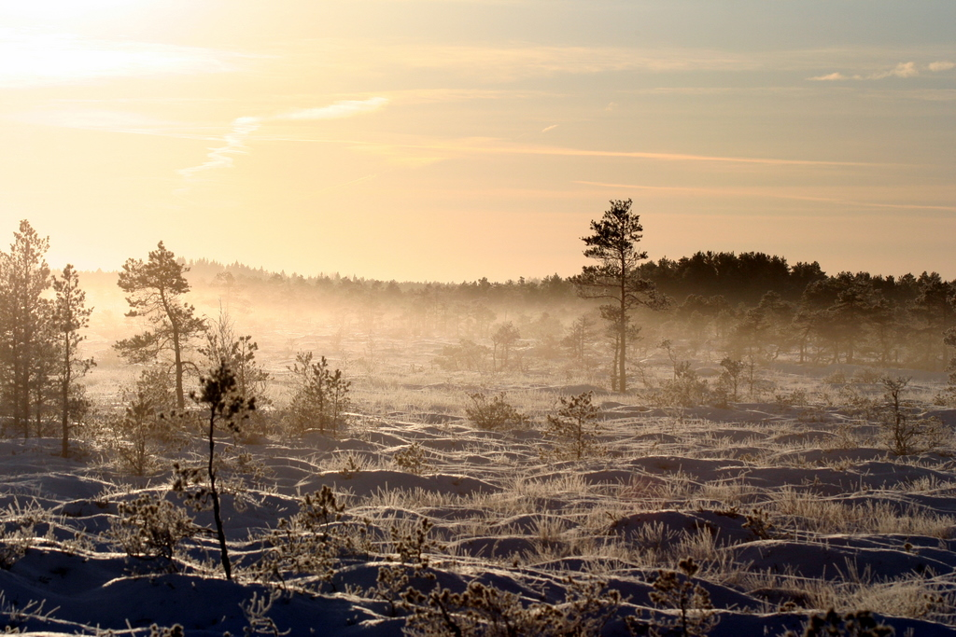
Why economic crisis occur?
because of the accumulation of the
wrong economic decisions
What for economists exist?

Slide 7
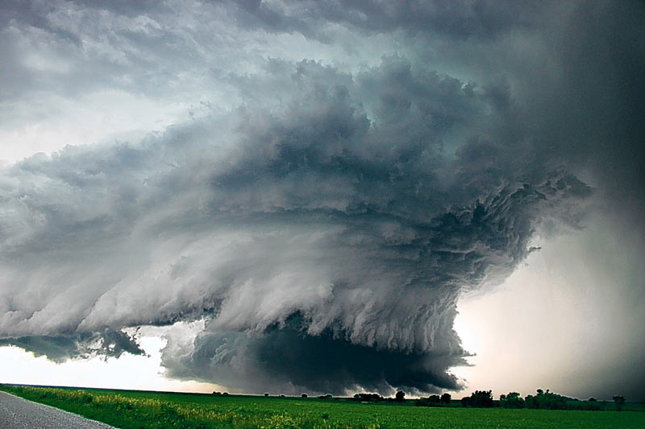
What crises is it?
This is not real estate crisis
This in not financial crises
This is not economic crisis
……
This is the crisis of values!

Slide 8


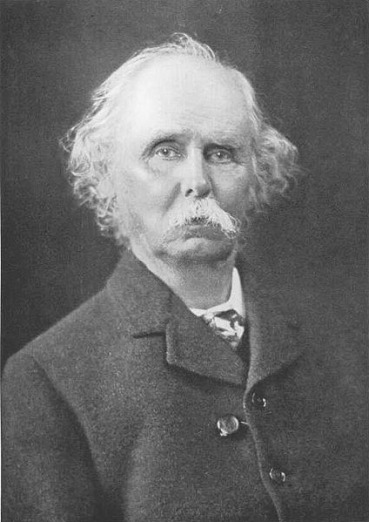

Neoclassical school of economics
Alfred Marshall (1842–1924)
Principles of Economics
1890
The more,
the better?

Slide 9

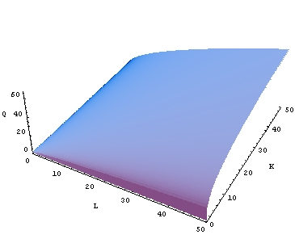
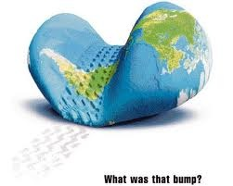
3 generations of real consumption
party
Cobb-Douglas Production Function
Q = total production (the monetary value of all goods produced in a year)
L = labor input
K = capital input
A = total factor productivity
Q = AL^{α}K^{β}

Slide 10
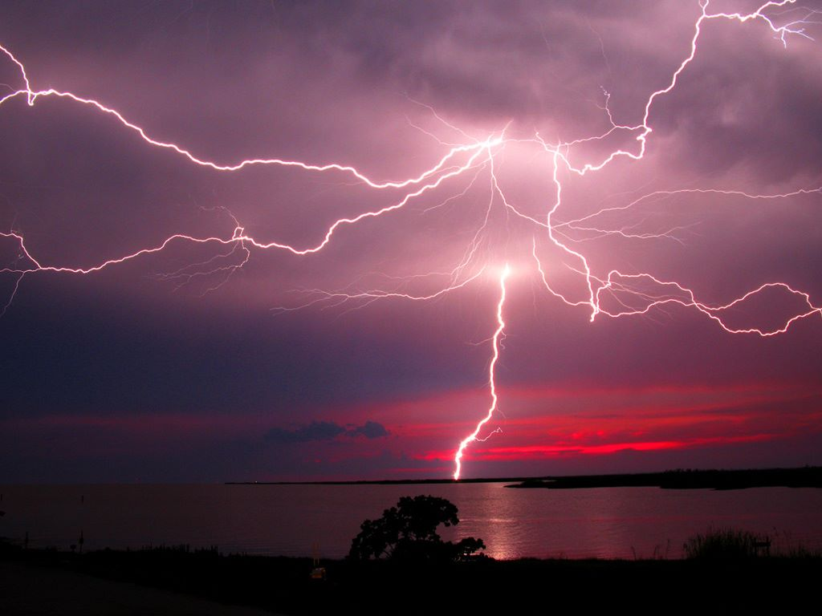
Why this is over?
The economic and social models
based on borrowed consumption
are over for ever!
Reasons:

Slide 11

Europe is old!
Above 65 as % of people in working age
Average of developing world
Average of developed world
Central, Eastern Europe
Europe
Latin America
Japan
Middle East, Central Asia
USA
Africa
Other
80
80
60
60
40
40
20
20
0
0
1950
75
2000
25
50
1950
75
2000
25
50

Slide 12
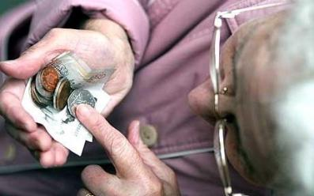
Europe is old!
Employed per one retiree (not employed person above 55)
How about the pension funds?
The trueth is …..
3,5
2000
3,0
2030
2,5
2,0
1,5
1,0
0,5
USA
UK
Germ.
France
Italy

Slide 13
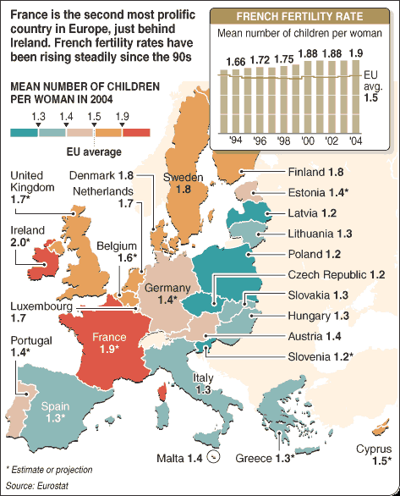
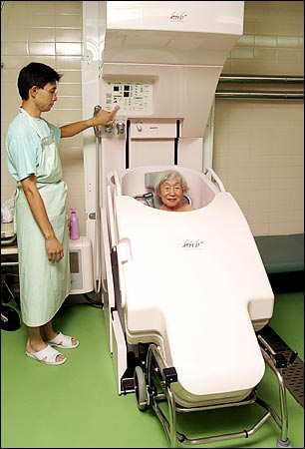
Europe is old!

Slide 14

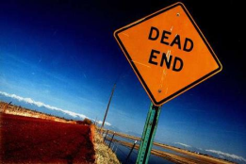

Where are the kids?
Birth rate: Italy – 1,32 USA – 1,9
Women labour participation rate:
Italy – 55% USA – 74%
Average retirement rate (women):
Italy – 54,8 USA – 64,2
Men aged 25-34 still living with the parents, 2008 (%):
Greece – 55, Italy, Portugal – 48, Spain – 41, Finland – 8
This is dead end!
… replacing kids with the consumption
Kids are
not just
liabilities!
They are assets as well!

Slide 15

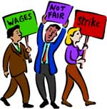
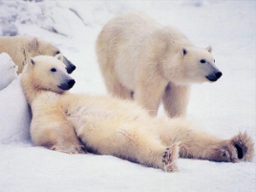
Europe is lazy!
Annual weeks worked (per employed person):
USA – 46,2 Sweden – 36,0
Holidays and vacation weeks:
Italy – 7,9 USA – 3,9
Absence due sickness or maternity (weeks):
Sweden – 3,7 USA – 0,96
Average employed german works 400 hours less than
american
Estonian – 1950 hours
Not to talk about productivity!

Slide 16
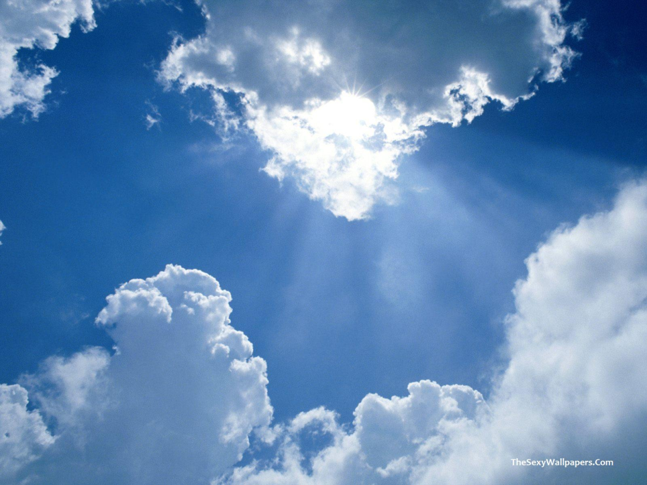
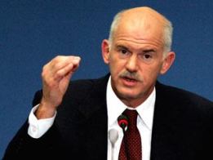
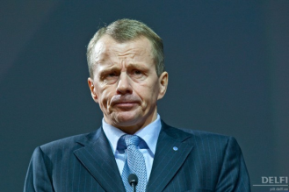
Europe is indebted!
Public debt 2010, % of GDP
140
120
100
80
60
Debt limit
40
20
EE
LU
LV
RO
LT
BG
SI
IE
DK
CZ
SK
FI
ES
SE
UK
PL
NL
CY
EU27
AT
MT
PT
FR
DE
HU
EA
BE
GR
IT
Allikas: Eurostat, Euroopa Komisjon

Slide 17
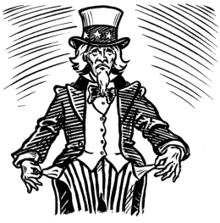
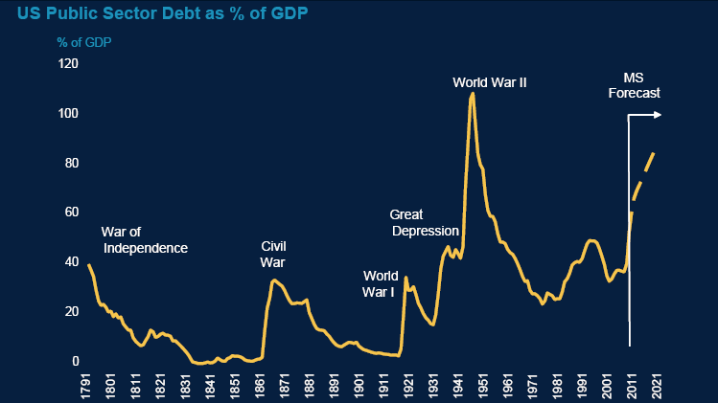
… and not just Europe
There is debt but no war

Slide 18
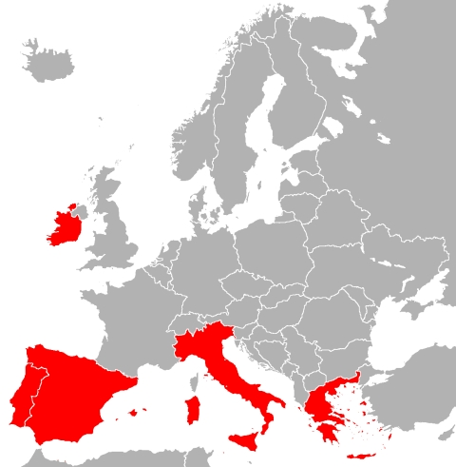
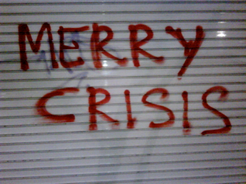
Europe is indebted!
Problem –
there is no honest
way out
- club “Bold and
Beautiful”

Slide 19
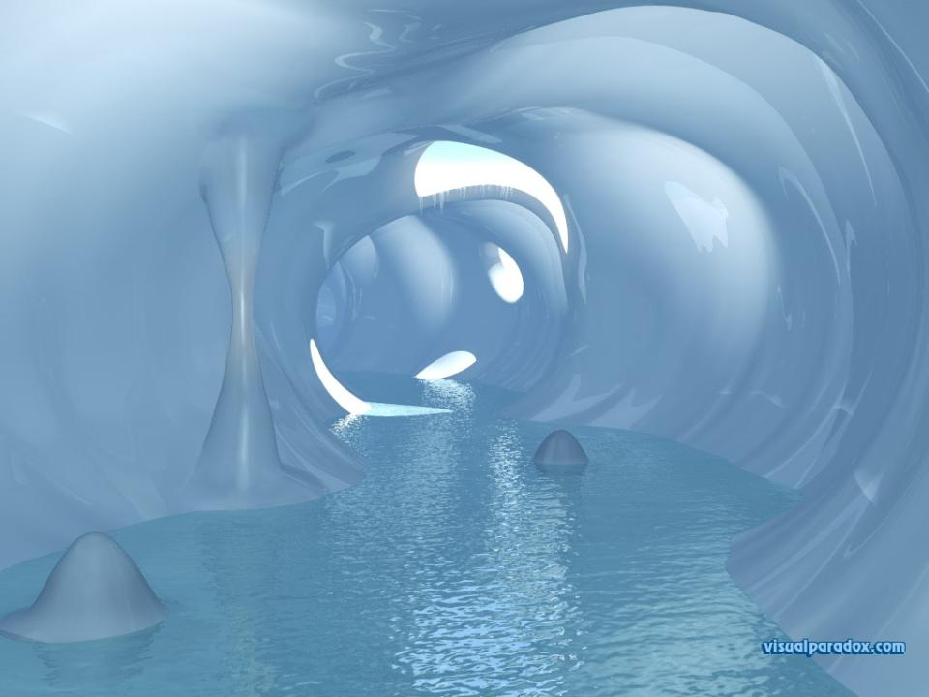
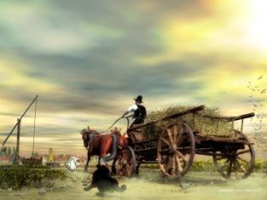
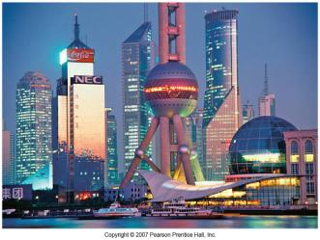
What’s in the end of the tunnel?

Slide 20
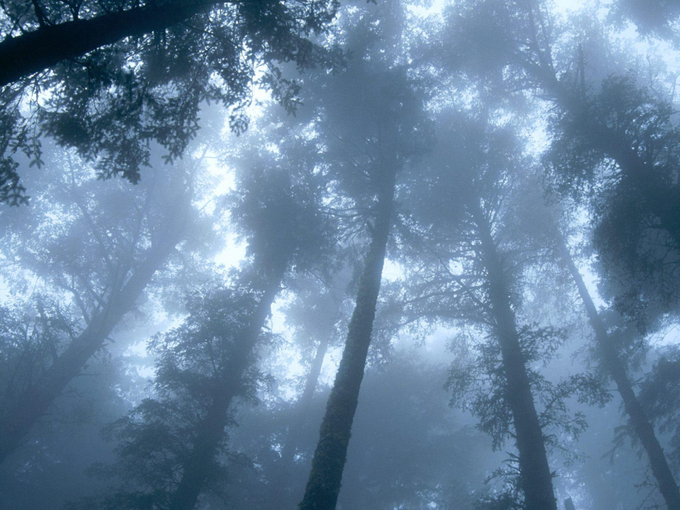
Is there any hope?
Yes there is:
there is still some capitalism
left in Baltics

Slide 21

There is still some capitalism!
We still do work (average 1900+ hours per year)
We are still cheap:
Average german – 30 eur per hour, estonian – 7 eur
Our labour markets are flexible:

Slide 22
Our labour markets are flexible

Slide 23
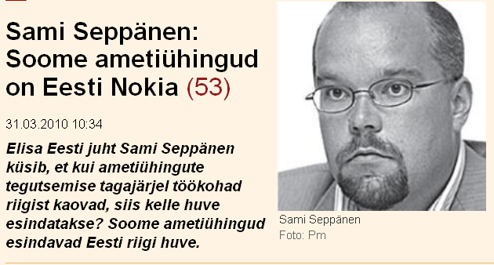
Finnish labour unions
= Estonian Nokia!

Slide 24
This is not
the crisis of capitalism!
This is the crisis of socialism!
The crisis of taking-care-society

